Slide 1
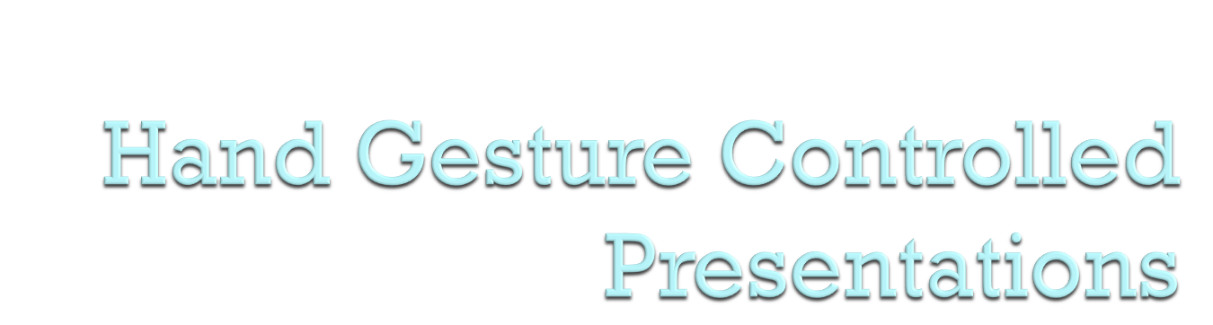
Mini Project by:
1602-21-737-170 Sai praneetha.S
1602-21-737-171 Sanath.M
1602-21-737-186 Vimalesh Guptha.G

Slide 2

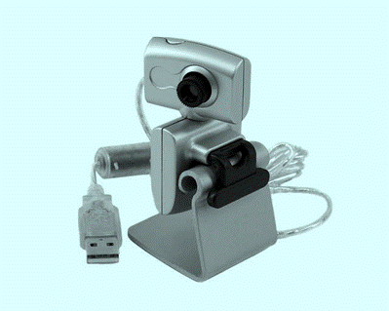
  Use Open cv for video Capturing
  Detecting hands using Hand Tracking Module
  Using MediaPipe hand landmarks assign new hand gestures

Slide 3

In Today’s world:
  Many devices with integrated cameras
  Many personal webcams
Our Goal:
  Overall, the goal of this project is to provide a cutting-edge technology solution that will enhance the presentation experience and improve the way presentations are conducted

Slide 4

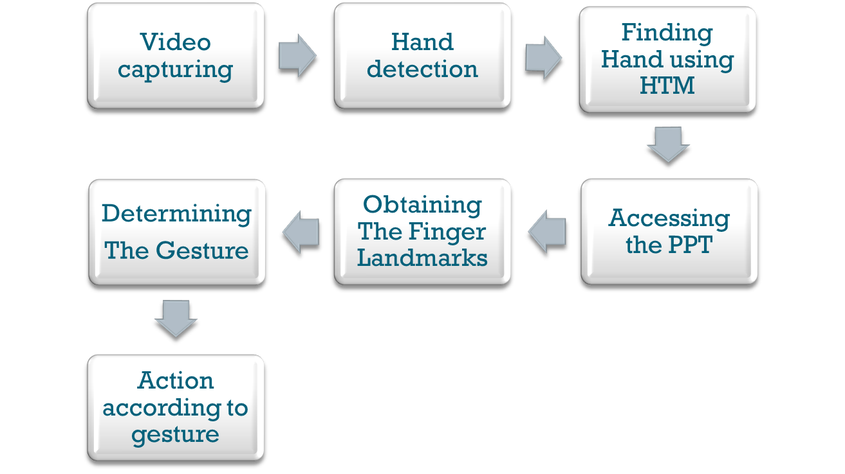
Notes:
Emphasis on motion?
Bring up previous talk – before we said media player, now we have changed it to include learning applications

Slide 5

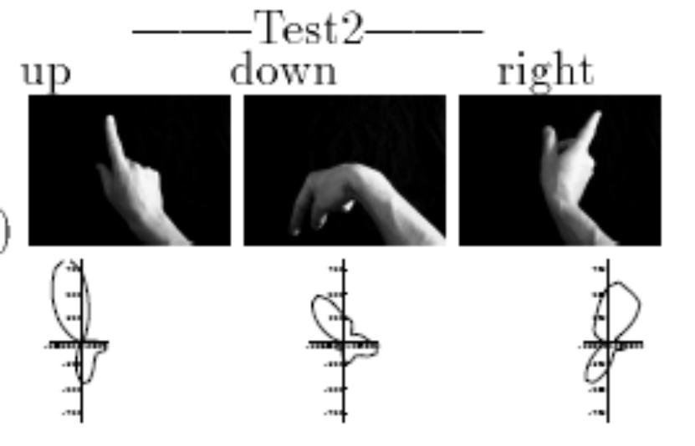
Freeman and Roth
For hand posture analysis
Creates histograms of local orientation using feature vectors from pixel intensity
Recognizes 10 gestures in real time

Slide 6

The approach for a hand gesture controlled presentation project involves setting up a camera to capture video frames, detecting hands in the frames using computer vision, mapping specific hand gestures to commands in a PowerPoint presentation using the Microsoft PowerPoint API, and continuously updating the presentation based on the detected hand gestures while displaying the resulting image

Slide 7

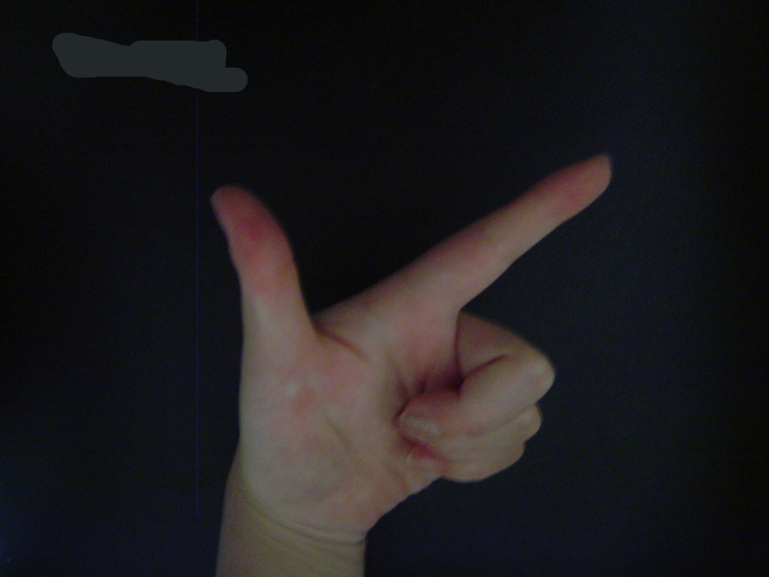
Video Capturing
Locate hand in image
Analyze hand gesture
  Finger region detection
  Pattern matching
Not real-time

Slide 8

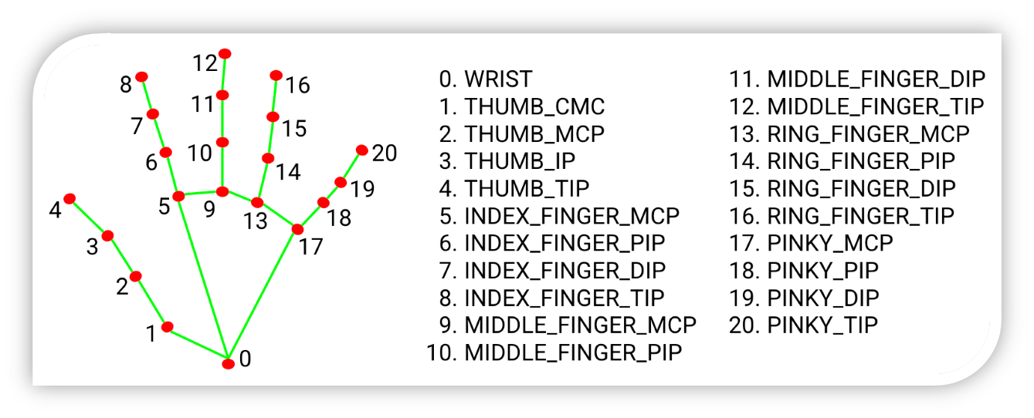
MediaPipe Hands
  Custom Hand detection built Model
  Real time Hand Tracking
  Only single Hand Detection

Slide 9
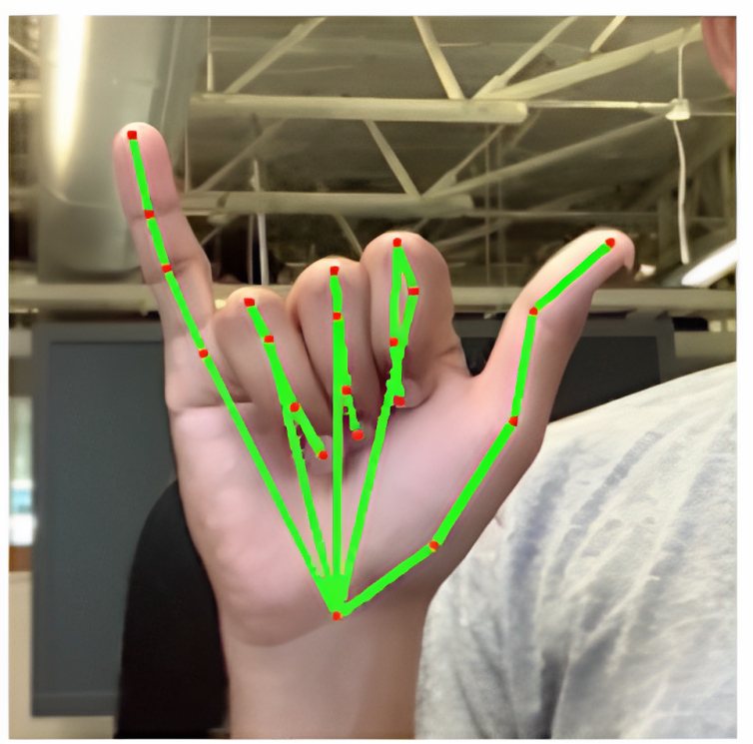
Hand Location
  Determines hand position in image using Find hands
  Fill in missing portions of hand
  Draw hands

Slide 10

Motion
  Static gestures & frame by frame analysis
  Allow for moving camera
  Gesture determination corrects obscurities or out of frame hand positioning

Slide 11

Multi-user support: Add capability for multiple users to control presentation
Improved accuracy: Use machine learning algorithms to improve hand detection accuracy
Enhanced gestures: Expand the range of hand gestures for more control options
Integration with other applications: Integrate with other software such as video conferencing platforms
Portable device support: Develop a portable device to control presentations wirelessly.

